Slide 1

Kavis Technology LLC Contract Manufacturing Services
11/12/2019

Slide 2
Introduction
We have been a contract manufacturing service provider to KLA Tencor since 2007.
We have signed NDA with KLA Tencor and we respect our customer’s intellectual property.
We have local facilities in Bay Area as well as overseas operations in Asia.
We offer off-shore price with local convenience.

Slide 3
Contract Manufacturing Services
Provide turn-key assemblies and kits, i.e., electro-mechanical assemblies, opto-mechanical assemblies.
Procurement of off-the-shelf material and components following the BOM.
US assembly house completes critical cleaning, assembly and packaging.
Closely follow customer’s specifications for material handling, plating, cleaning, and packaging.

Slide 4
Quality, Cost, Efficiency
US assembly house for quality assurance, final cleaning, and assembly based on customer requirement.
Global outsourcing for machining to help achieve the cost-down objectives of our customers.
Typical delivery is 3 weeks . 2-week delivery and 1-week delivery available for urgent jobs.

Slide 5
Offshore Capabilities
Precision Machining:
CNC Milling & Turning, Lapping, Grinding
EDM
Cold stabilization
Sheet metal (less than 1-meter length)
Laser cutting, laser welding
Ceramics manufacturing:
Silicon Carbide
Zirconia
Fiberglass

Slide 6
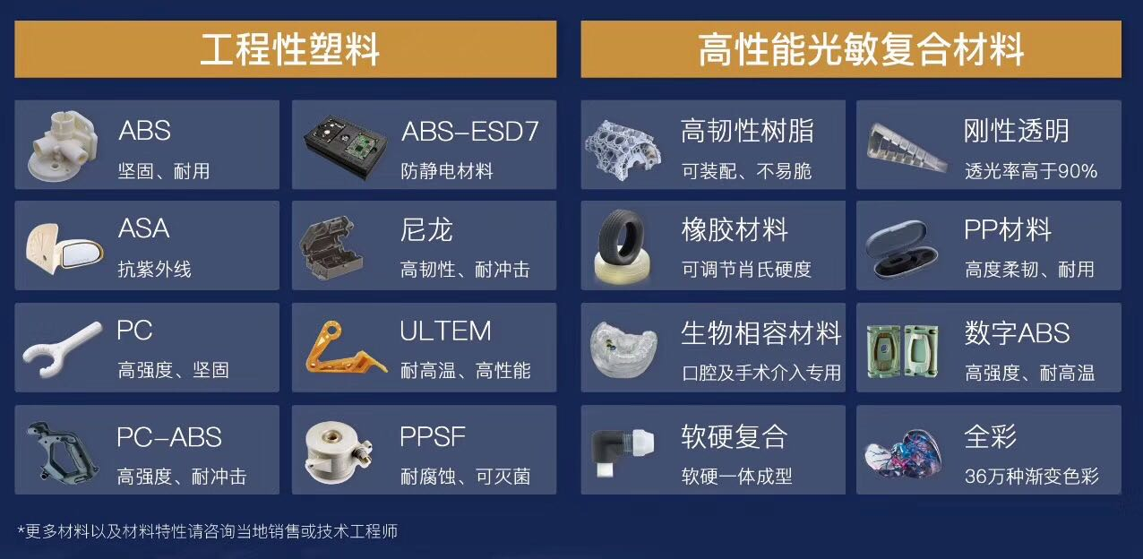
Offshore Capabilities
3D printing:

Slide 7
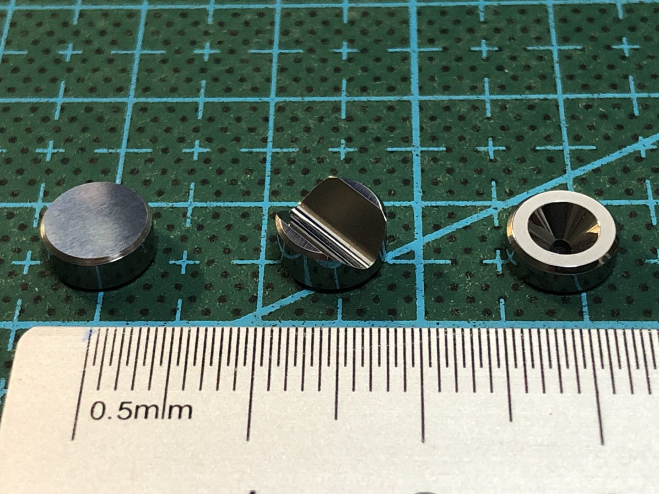
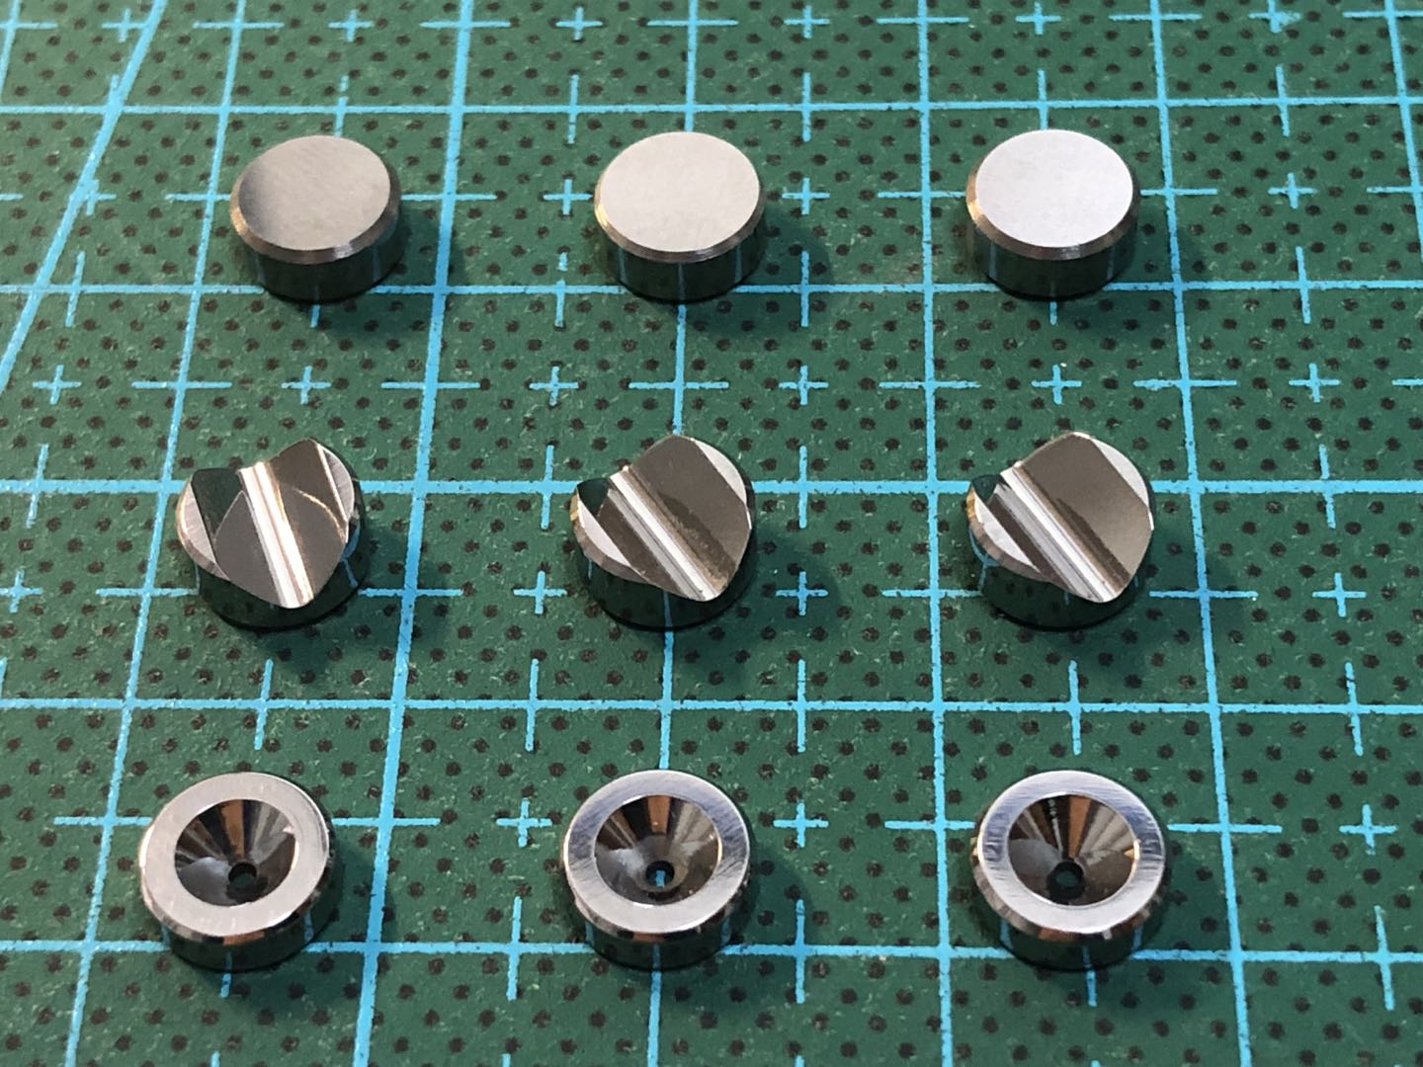
Offshore Capabilities
Hard metal machining

Slide 8
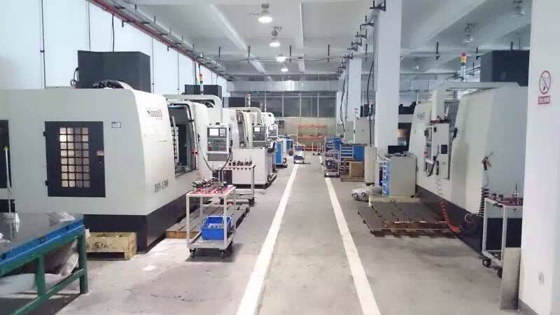
Machining Facility in Asia

Slide 9
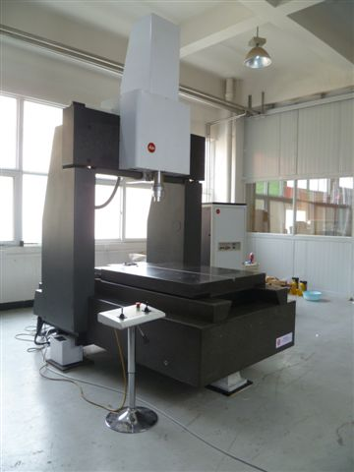
Metrology
Leitz PMM 12106: 1um
Mahr: 0.01um
TESA: 0.1um

Slide 10
In House Tool & Equipment List

Slide 11
Bay Area Local Facilities
Parts cleaning for photo-contamination control at TMPI in Hayward.
Incoming inspection and assembly in Class 1000 clean room in Hayward, CA.
Electroless nickel plating and Colored hard anodize at Electro Plating Specialties (EPS) in Hayward.
Re-work and non-compliance materials handling at Tridecs Precision Machining in Hayward.
Inventory and spare parts in Hayward.

Slide 12
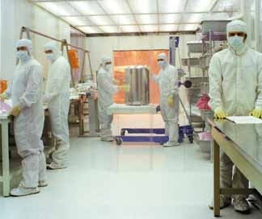
Special Cleaning
All assemblies and components near UV optics require special cleaning at the KLA certified cleaning houses like TMPI, Alantac, Sun Surface
Special packaging is also required.

Slide 13
Surface Treatment
Anodize (Mil-A-8625, Type II)
Hard anodize (Mil-A-8525, Type III)
Alodine
Electroless nickel plating
Passivation

Slide 14
Commonly Used Materials
Metal:
Alum 6061, 5052, 7075, MIC-6
Stainless Steel, Invar/Kovar
Copper, Brass, BeCu, Titanium 6AL-4V
Plastic:
Teflon, Delrin, Fiberglass
PEEK, Semitron, Ertalyte, UHMW
Ceramic:
Silicon carbide
Alumina, Zirconia

Slide 15
Quality Assurance
Full compliance with ISO and US Mil-specifications for special materials, tooling and handling.
Incoming inspection at the assembly house in Hayward, California.
Critical surface treatment concerning photo contamination is done at EPS in Hayward.
First article full inspection report.

Slide 16
We offer more than just machining and assembly: We offer Solutions
We work with customer engineers closely to solve problems, suggest improvements, and deliver quality products on time.

Slide 17
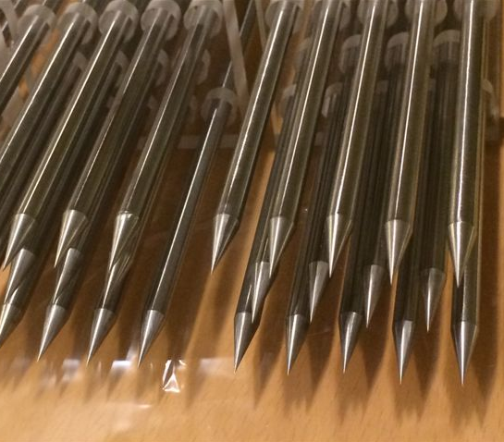
Example Project
Requirement Spec:
Non-magnetic
Sharp tip
0.1um roughness
5mm +/- 6um
50um/70mm straightness

Slide 18
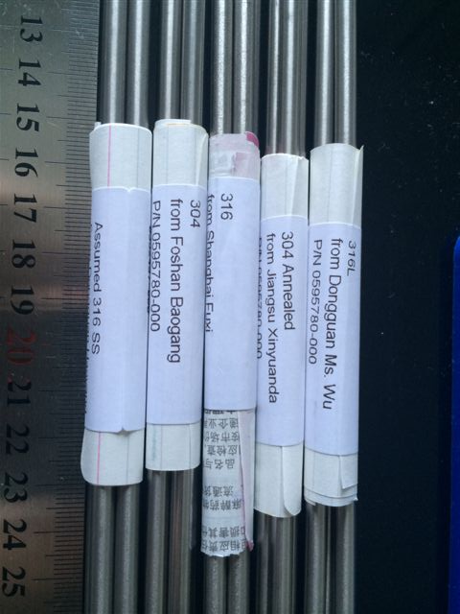
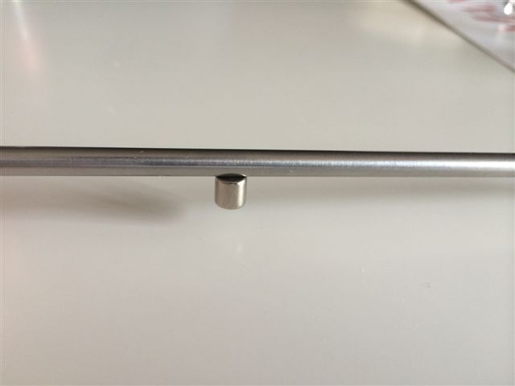
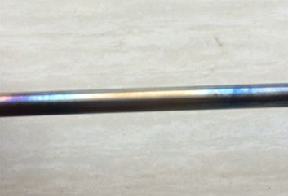
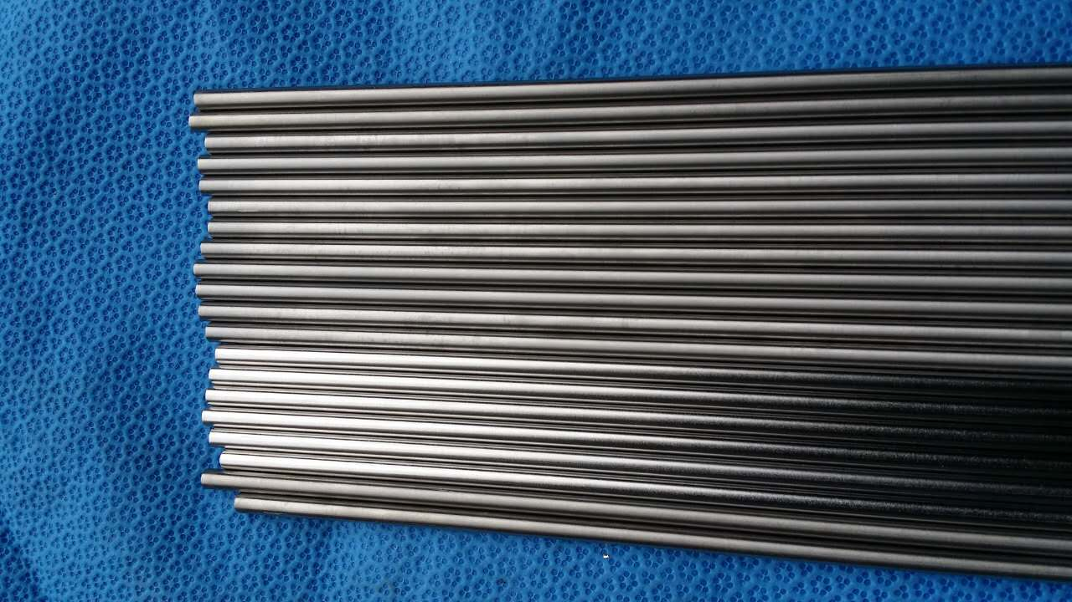
Material Selection
Permeability Test
Annealing Test
Surface Roughness Enhancement
Packaging
Electro-polishing
vs. grinding

Slide 19
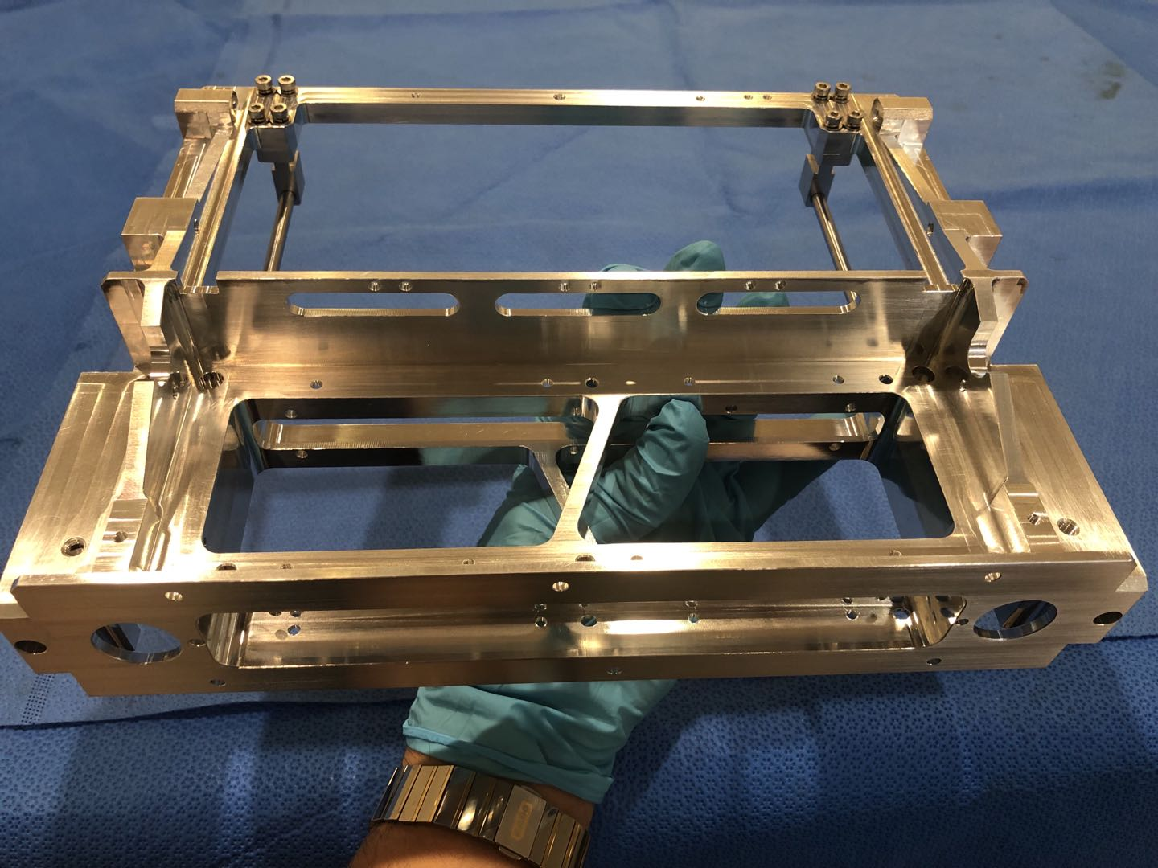
DFA Bracket

Slide 20
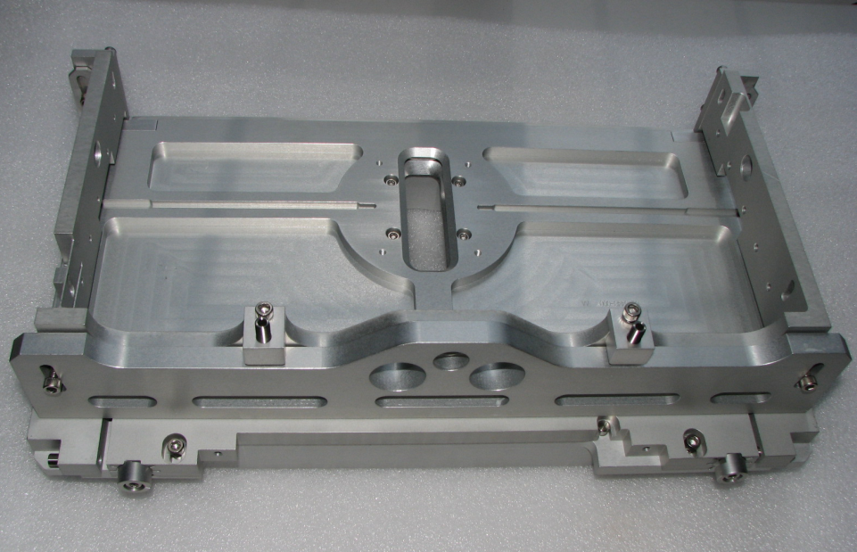
Camera Mount Assembly

Slide 21
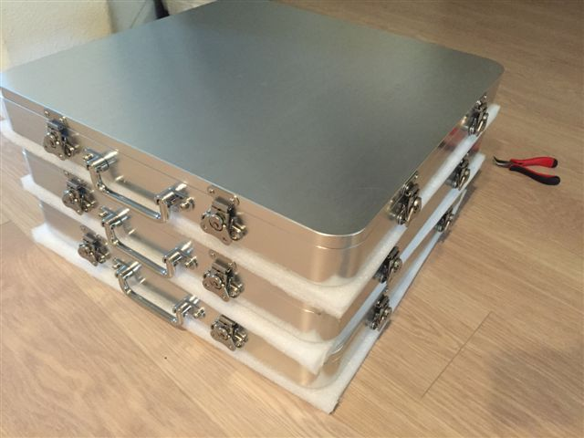
450mm chuck case

Slide 22
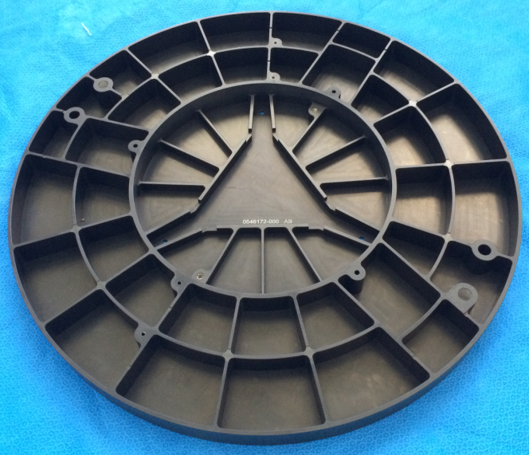
450mm chuck: flatness = 5um

Slide 23
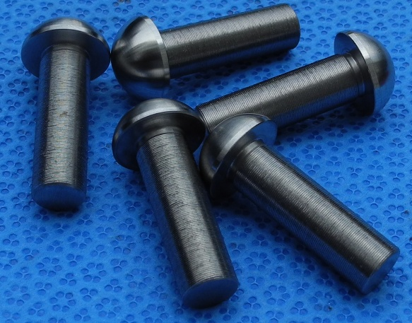
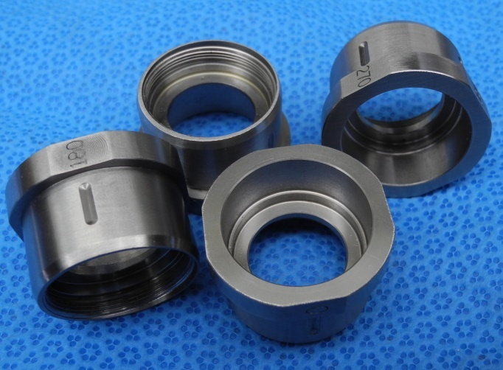
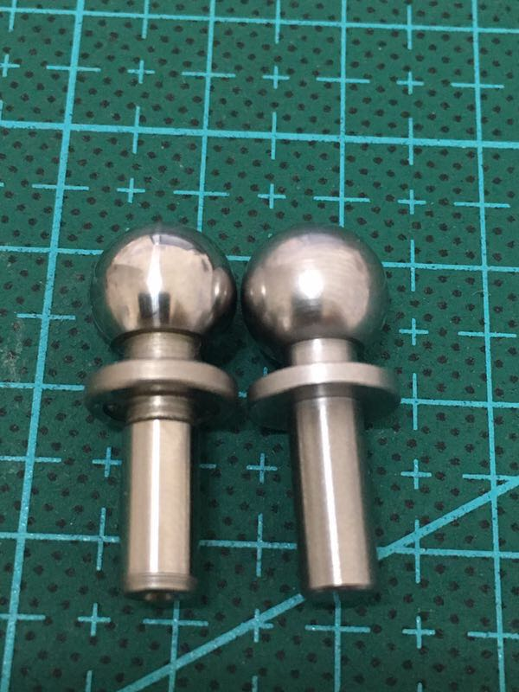
CRES-440

Slide 24
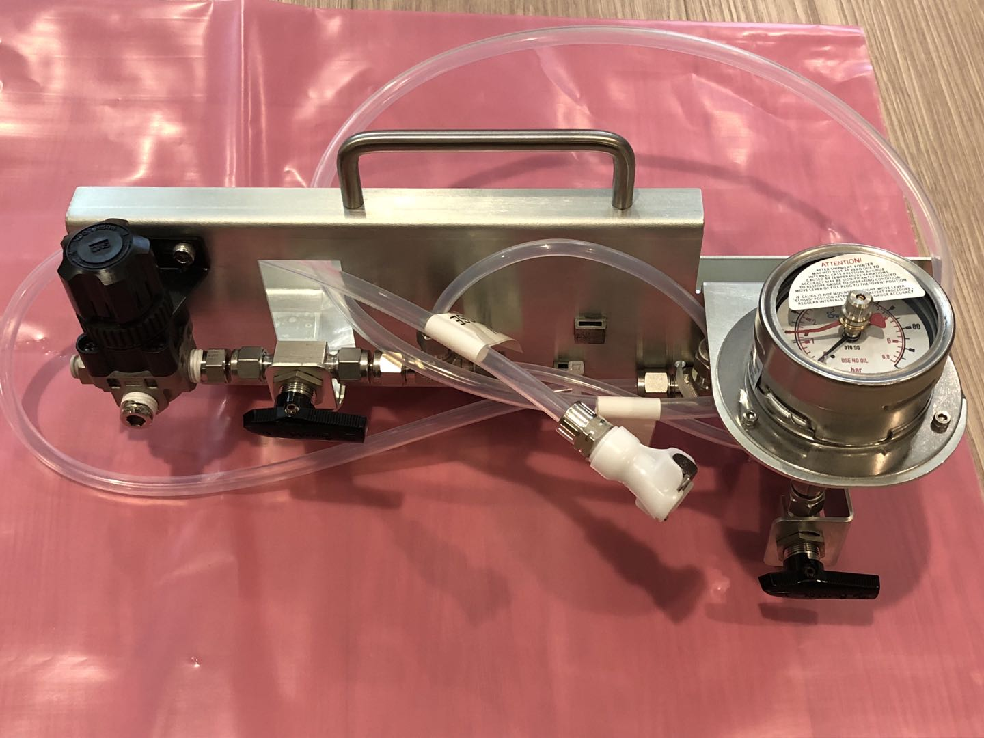
Field Service Tooling

Slide 25
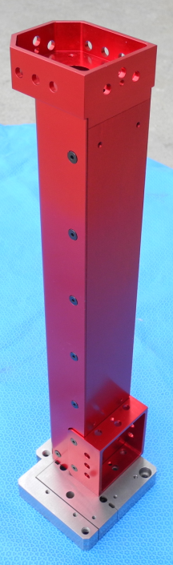
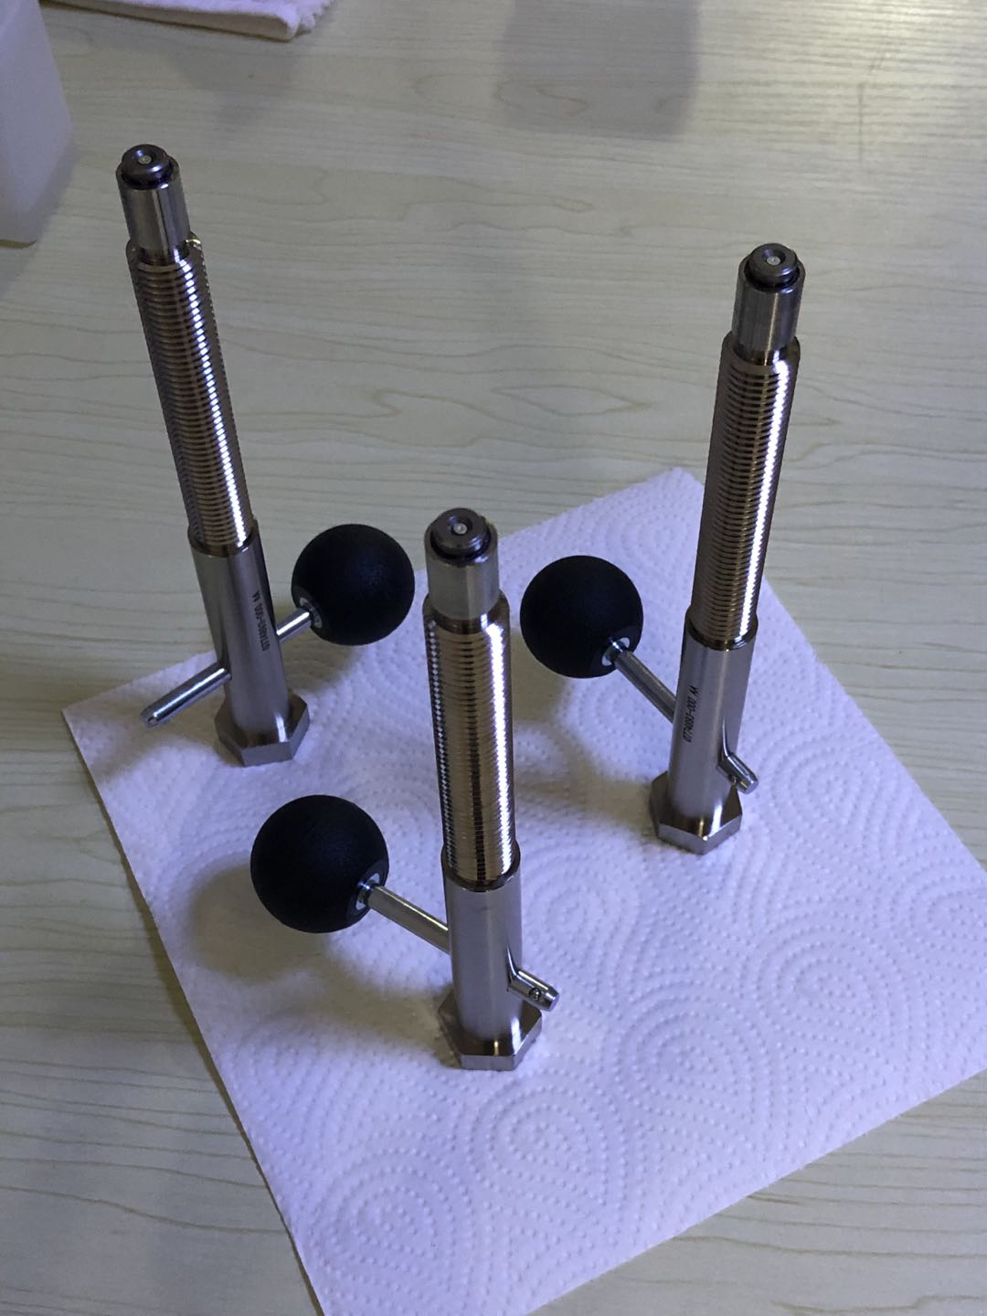
Tooling Assembly

Slide 26
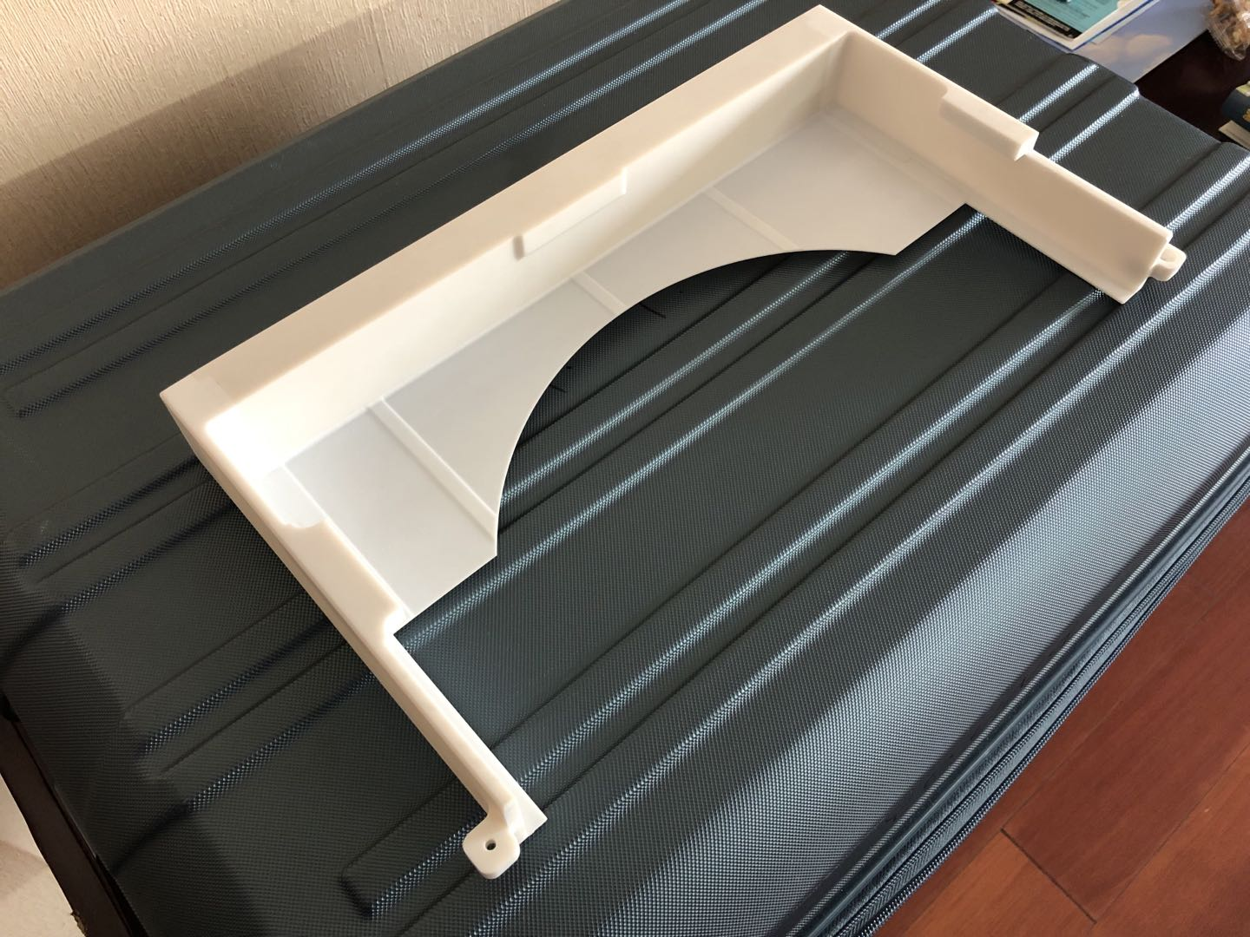
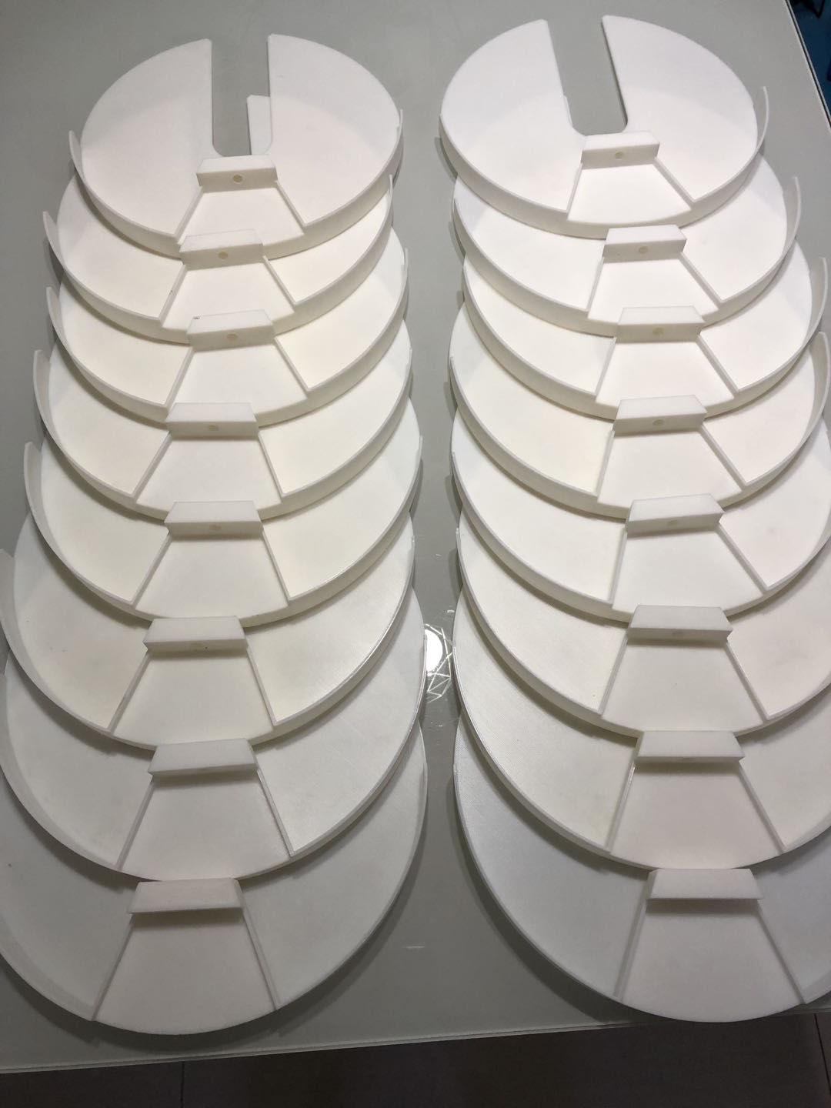
3D Printing

Slide 27
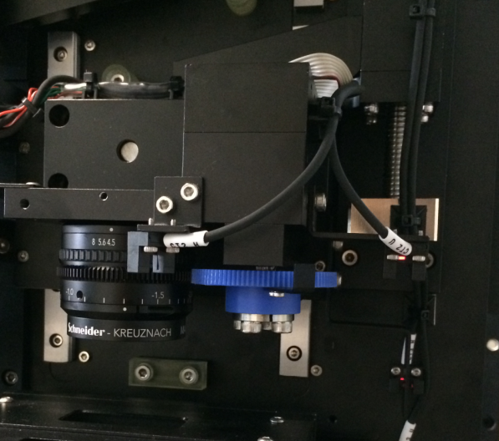
Examples of Electro-Mechanical assembly
MicroMo motor inside for zoom operation

Slide 28
Contact Info
San Jose Office
1646 Lorient Terrace
San Jose, CA 95133, USA
Tel (510) 825-2035, Fax (877) 708-3447
Email: tyoung@kavis-tech.com
Hayward Office
3401 Investment Blvd. #10
Hayward, CA 94545
USA

